Slide 1
CPBP 8306: Data cleaning day 1
Stevenson Science & Engineering Library
Joshua Borycz

Slide 2
GitHub Desktop

Slide 3
Setting up a GitHub repository
Create a GitHub account
Download and install GitHub desktop
GitHub Desktop > Settings > Sign Into GitHub.com > Follow security instructions in browser
File > New repository > Select name, description, path, initialize README > select none for Git Ignore & License
Publish repository > Choose name, description, & keep code private > none for Organization
Congratulations! The world now knows you can code!
Notes:
we’ll demonstrate how to set up search alerts for queries in databases
Also run through a few searches in these
Mostly focusing on SciFinder

Slide 4
Using a GitHub repository
A commit saves your code at a moment in time with a title and description to a particular branch
A branch is a version of your code that will not impact other versions (main/master branch is like the trunk of the tree)
You can pull (a.k.a. Fetch origin) the remote repository, on GitHub.com to your computer
You can push the local repository, on your computer, to GitHub.com
You can merge branches when you want to combine changes to code. All differences will be tracked.
Notes:
we’ll demonstrate how to set up search alerts for queries in databases
Also run through a few searches in these
Mostly focusing on SciFinder

Slide 5
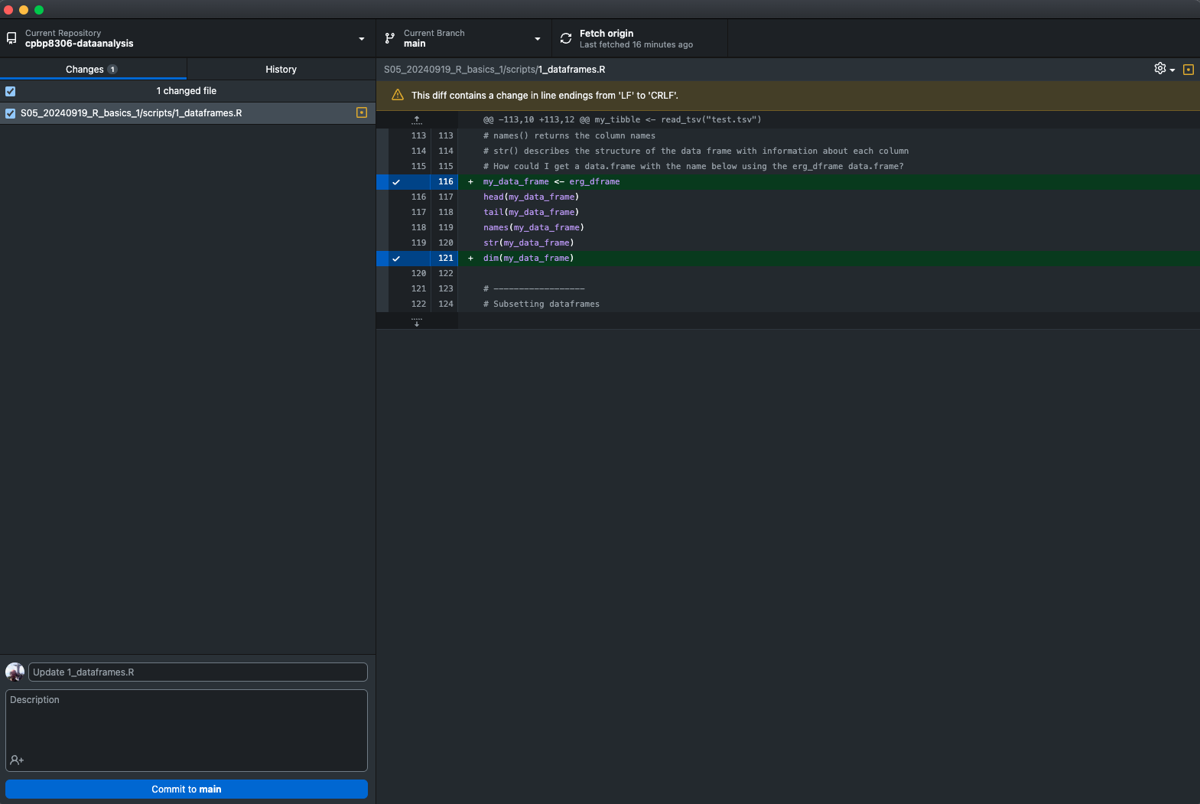
Using a GitHub repository
List of changed files
Changes to code
Write commit
Notes:
we’ll demonstrate how to set up search alerts for queries in databases
Also run through a few searches in these
Mostly focusing on SciFinder

Slide 6
Cleaning data

Slide 7
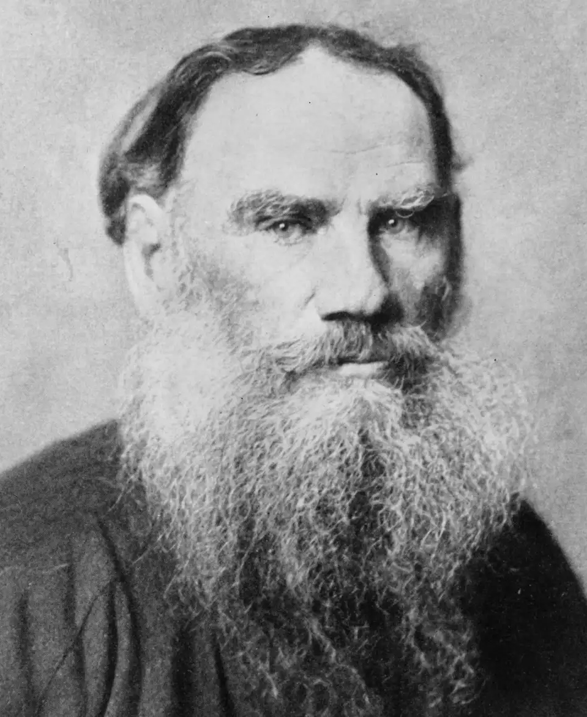
Cleaning/tidying data
“Happy families are all alike; every unhappy family is unhappy in its own way.” –– Leo Tolstoy
“Tidy datasets are all alike, but every messy dataset is messy in its own way.” –– Hadley Wickham
80% of the data analysis process is cleaning and interpreting data
20% is doing cool viz
Always keep a copy of the raw data
Always save the cleaned data file you use for analysis
Leo Tolstoy
Notes:
we’ll demonstrate how to set up search alerts for queries in databases
Also run through a few searches in these
Mostly focusing on SciFinder

Slide 8

Tidy data
There are three fundamental principles of tidy data:
Each variable forms a column
Each observation forms a row
Each cell is a single measurement or value
Notes:
The formal definition of tidy data from Hadley’s paper
What’s nice about TidyData is that the suggestions are easy to remember and apply to any data
The principles of tidy data are closely tied to relational databases and Codd’s relational algebra (Codd 1990),
Attempt to reach third normal formal,
framed in a language familiar to statisticians and conceptually easy to remember and apply
Hadley Wickham defines "tidy data" is data stored in "3rd normal form". Restated in language used by statisticians and data scientists
With a standardized framework for how your data should look, you spend less time on data cleaning and wrangling, and more time to focus on answering the problem at hand.
It’s also a good practice to have your data in this format, which makes it reproducible and it’s easy for others to understand.

Slide 9

Three common problems with messy datasets
Column headers are values, not variable names
Variables are stored in both rows and columns
Multiple variables are stored in one column

Slide 10
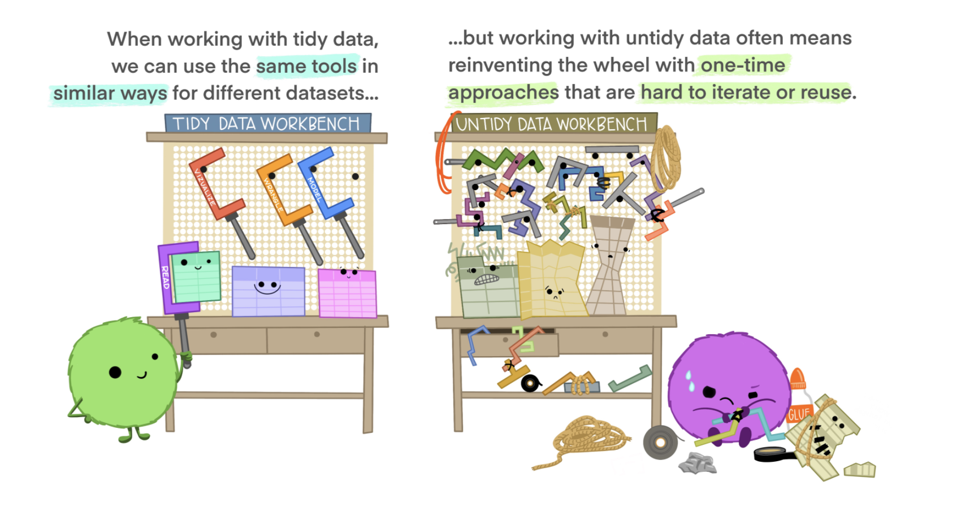
Lowndes, J., & Horst, A. (2020, October 12). Tidy data for efficiency, reproducibility, and collaboration. Openscapes. https://www.openscapes.org/blog/2020/10/12/tidy-data//
Notes:
Tidy data for more efficient data science
Tidy data allows you to be more efficient by using existing tools deliberately built to do the things you need to do, from subsetting portions of your data to plotting maps of your study area. Using existing tools saves you from building from scratch each time you work with a new dataset (which can be time-consuming and demoralizing). And luckily, there are a lot of tools specifically built to wrangle untidy data into tidy data (for example, in the tidyr package). By being more equipped to wrangle your data into a tidy format, you can get to your analyses faster to start answering the questions you’re asking.

Slide 11
dplyr
dplyr is a grammar of data manipulation, providing a consistent set of verbs that help you solve the most common data manipulation challenges:
mutate(): adds new variables that are functions of existing variables
select(): picks variables based on their names.
filter(): picks cases based on their values.
summarize(): reduces multiple values down to a single summary.
arrange(): changes the ordering of the rows.
group_by(): which allows you to perform any operation “by group”
Notes:
we’ll demonstrate how to set up search alerts for queries in databases
Also run through a few searches in these
Mostly focusing on SciFinder

Slide 12
dplyr cheat sheet
GitHub link: https://github.com/rstudio/cheatsheets/blob/main/data-transformation.pdf
Notes:
we’ll demonstrate how to set up search alerts for queries in databases
Also run through a few searches in these
Mostly focusing on SciFinder

